Slide 1
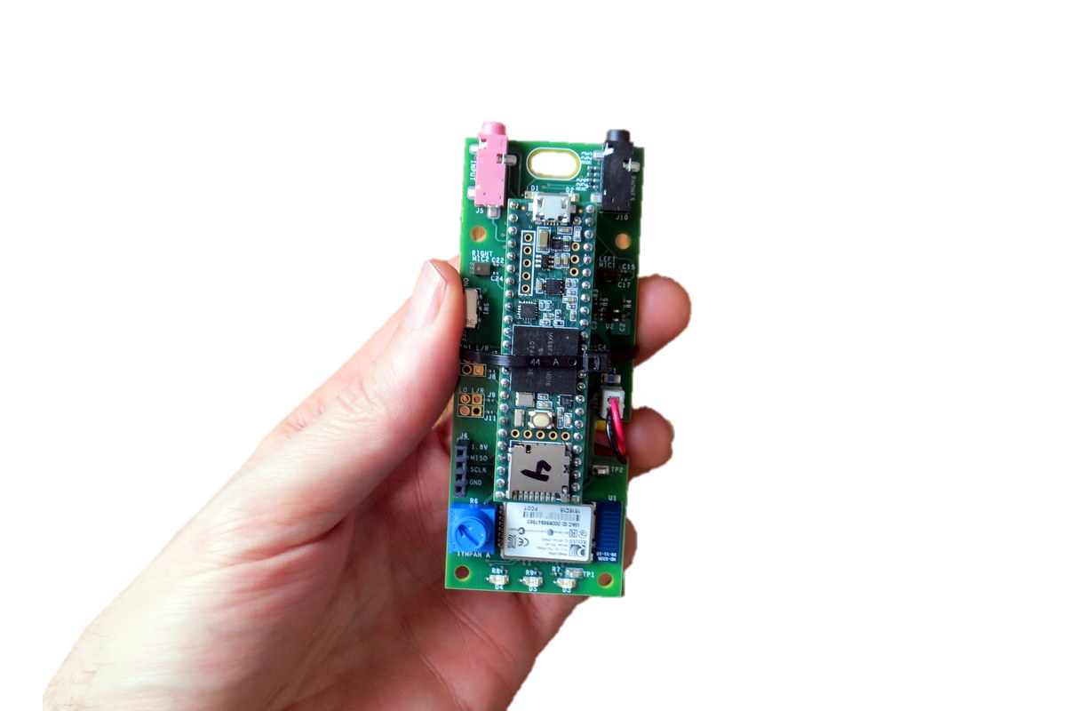
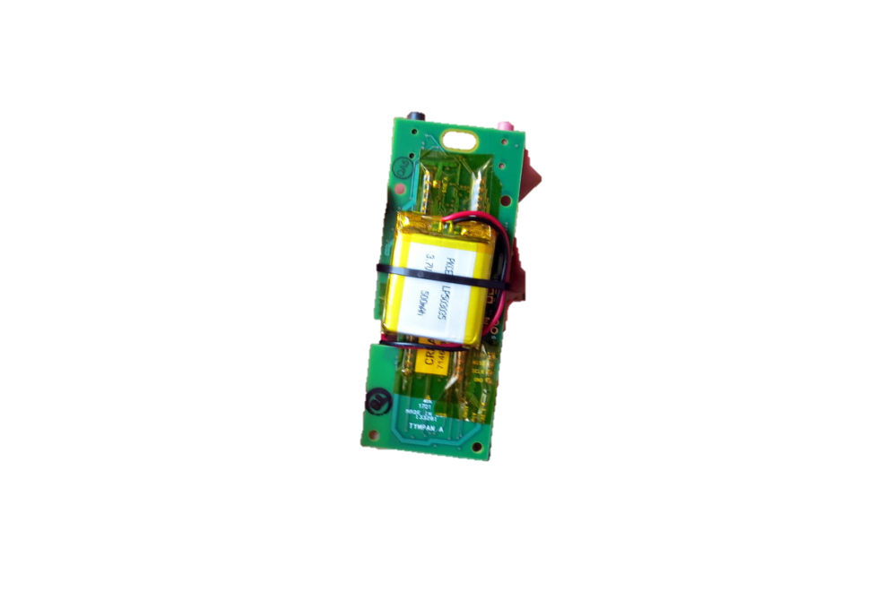
Tympan Rev A/C Hardware
USB to
Program/Recharge
Line-In / Mic Jack
Headphone Jack
On-Board Mic
On-Board Mic
Power
Switch
Li-Po Battery on Back
Bluetooth
Classic
User Pot
(Volume)
User
LEDs

Slide 2
Tympan Rev E, Goals
Goals:
Primary Goal: Smaller
Secondary Goals: Lower cost, more attractive, BLE, better microphones
Approach:
Integrate Teensy into Tympan Board, Swap BT Module, Shrink PCB Size, Possibly Change Mics
Unknowns: Which BLE Module, Which Mics

Slide 3
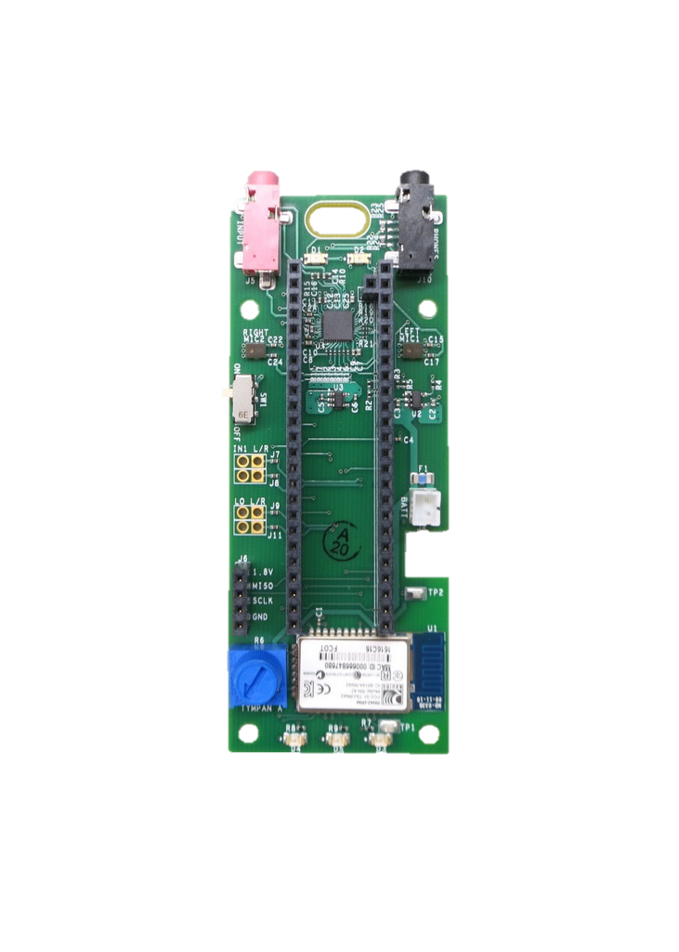
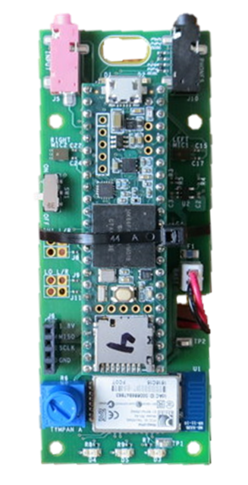
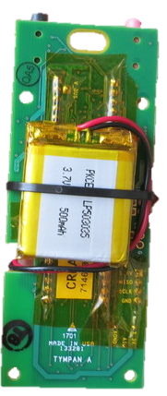
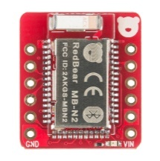
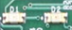
Tympan Rev E Ideas
Li-Ion Battery: (add extra room for wires)
Adafruit: 2000mA-hr: 2.4” x 1.4” x 0.3”
Adafruit: 500 mA-hr: 1.15 x 1.4 x 0.19”
Sparkfun: 400 mA-hr: 1.06 x 1.48 x 0.2”
Li-Ion Battery: (add extra room for wires)
Adafruit: 500 mA-hr: 29 x 36 x 4.76 mm
Sparkfun: 400 mA-hr: 26.5 x 36.9 x 5 mm
battery

Slide 4
Tympan Rev E Ideas
Li-Ion Battery: (add extra room for wires)
Adafruit: 500 mA-hr: 29 x 36 x 4.76 mm
Sparkfun: 400 mA-hr: 26.5 x 36.9 x 5 mm
Li-Ion Battery: (add extra room for wires)
Adafruit: 500 mA-hr: 1.15 x 1.4 x 0.19”
Sparkfun: 400 mA-hr: 1.06 x 1.48 x 0.2”
battery
Top
Bottom
Cover (Ick!)

Slide 5
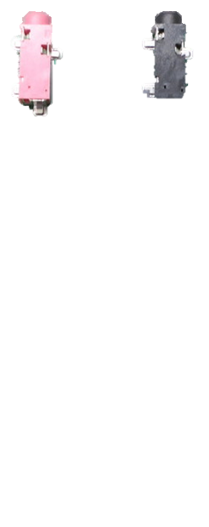
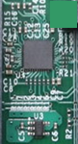
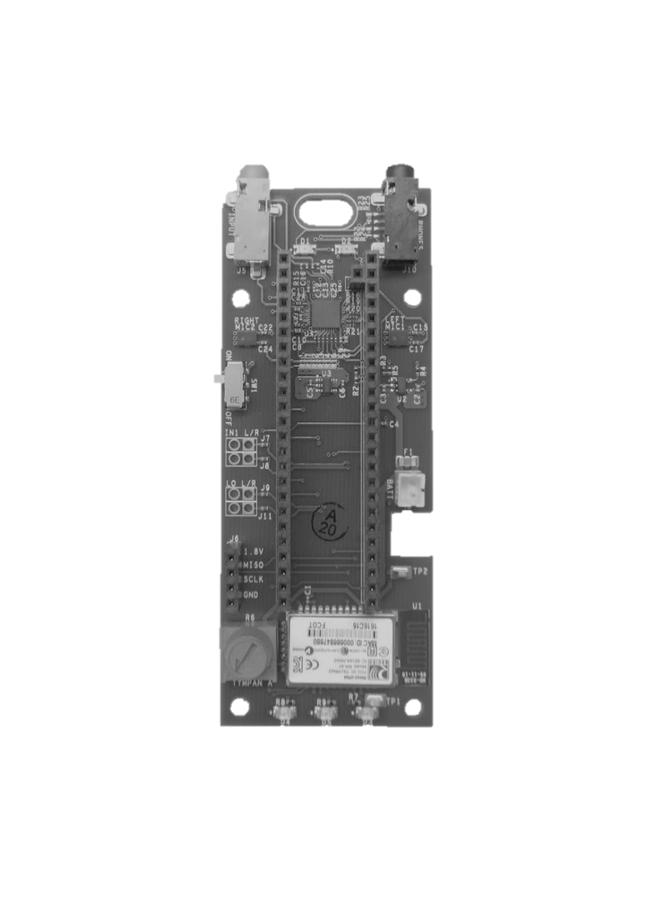
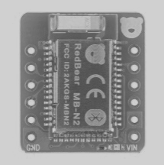
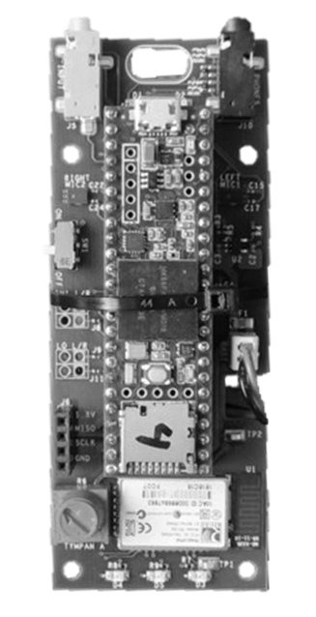
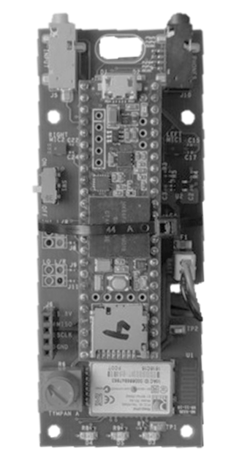
battery
battery
battery
Gray things are keepouts for stuff on the opposite site

Slide 6
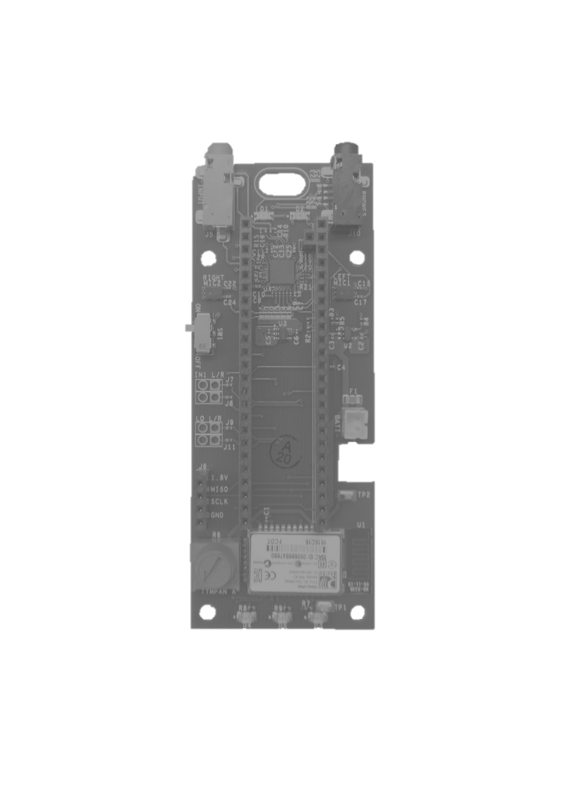
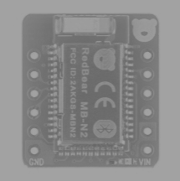
Best as of 1/18/2018, 4:35pm
Top
Bottom
Covered
Battery Sizes
1200mA
Battery
(0.2” thick)
500mA
Battery
500mA
Battery
(0.2” thick)
Gray things are keepouts for stuff on the opposite site

Slide 7
Comparison
Existing Tympan (PCB 3.81” x 1.51”)
WEA Concept
Jan 18, 2018
(PCB 2.87” x 1.55”)
1200mA-hr
(0.2” thick)
500mA-hr
Battery
(0.2” thick)
Stack of 3 Elements
(Battery+Typman+Teensy)
1.1” tall in enclosure.
Stack of 2 Elements
(Battery+Typman)
~0.75-0.8” in enclosure.
Battery
Sizes

Slide 8
Making Daughter Cards

Slide 9
Daughter Cards?
3.3V
Fancy Microphone
(with Battery Bias)
Second AIC
(4-channel sound!)

Slide 11
batteries
Li-Ion Battery: (add extra room for wires)
Adafruit: 2000mA-hr: 2.4” x 1.4” x 0.3”
Adafruit: 1200mA-hr: 2.4” x 1.3” x 0.2”
Adafruit: 500 mA-hr: 1.15 x 1.4 x 0.19”
Sparkfun: 400 mA-hr: 1.06 x 1.48 x 0.2”
500
Battery
(0.2” thick)
1200
Battery
(0.2” thick)
2000
Battery
(0.3” thick)

Slide 12
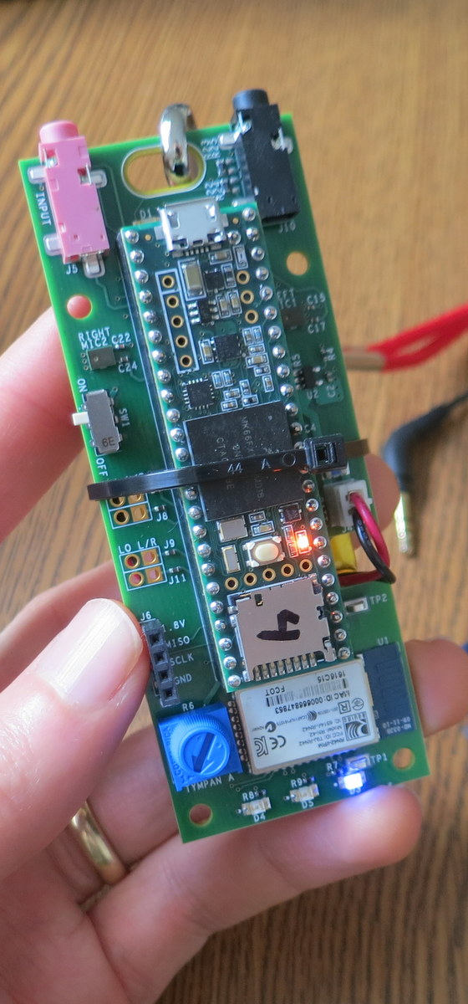
Hardware Specs
Processor
NXP MK66F (ARM Cortex M4F Core)
180 MHz with Floating-Point Unit
Analog-Digital
Texas Instruments TLV320AIC3106, stereo ADC and DAC
32/24/20/16-bit configurable (93 dB SNR)
Low-noise, software-controllable gain on inputs
Software-controllable microphone bias
Software-controllable headphone amplifier
Data Interfaces
USB Serial, USB Audio, USB HID
Bluetooth Classic
SD Card
Digital microphone port
Power
Draws about 100 mA @ 3.7V.
Power from USB or Li-Po Battery
On-board recharging from USB (with indicators)
Programming
Reprogram via USB. Program in C/C++.
Free, open-source toolchain
User Interaction
Potentiometer, LEDs, Bluetooth

